Slide 1
TikTok
SENTIMENT ANALYSIS

Slide 2
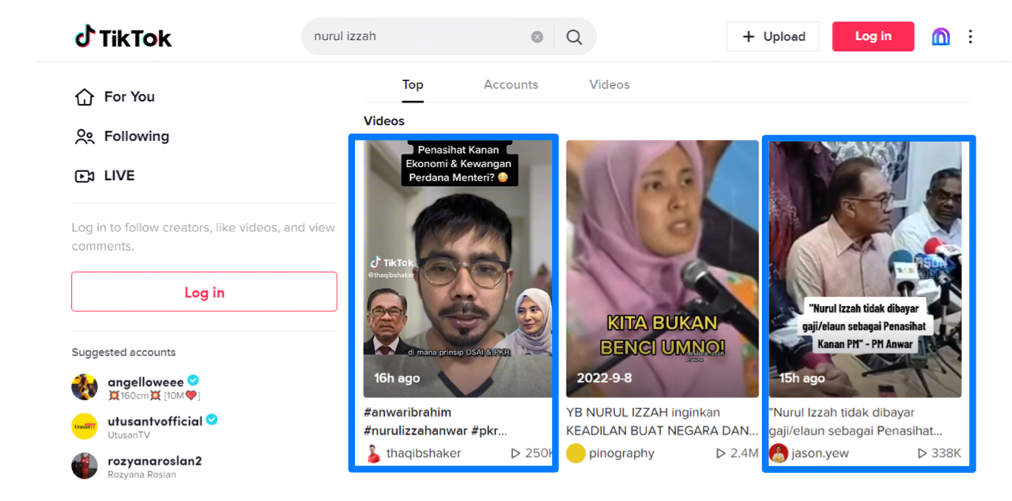
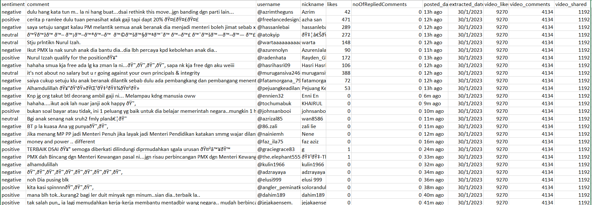
Background
Keyword: “nurul izzah”
Scrape from: Two videos below in blue boxes
Posted date: from 29/1/2023 - 30/1/2023
Scraped date: 10:30 am, 30/1/2023
Total sentences scraped: 1074
Scraped videos
Snapshot of the raw data

Slide 3
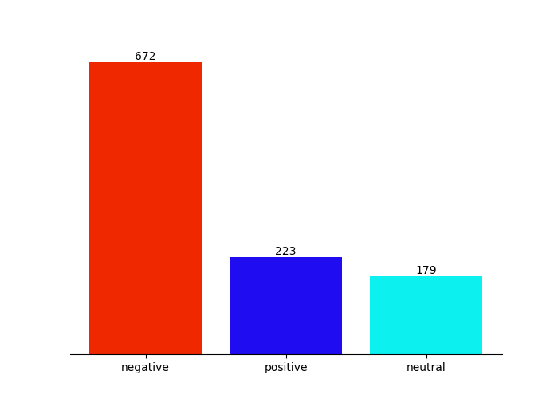
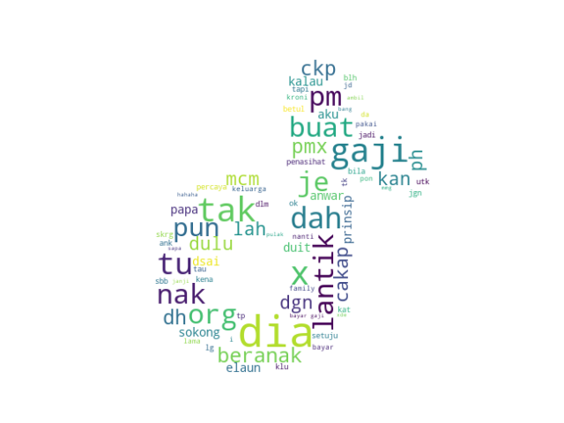
Overview analysis
Wordcloud
Sentiment

